Slide 1
AWS Storage Services
EBS Snapshots / volume
S3 Storage Classes
Glacier Vault Lock / S3 Object Lock
Amazon (S3) - Versioning /Amazon (S3) - Replication
Cross-Region replication (CRR) / Same-Region replication (SRR)
DNS/ AWS Route 53 / Feature Of Route 53
Sub-domain
Single Point Of Failure / Elastic Load Balancing
High Availability / Fault Tolerance
Types Of Load Balancers In AWS
A Launch Template
VPC

Slide 2
AWS Storage Services
Object Storage –
Applications developed in the cloud often take advantage of object storage's vast scalability and metadata characteristics. Object storage solutions like Amazon Simple Storage Service (S3) are ideal for building modern applications from scratch that require scale and flexibility, and can also be used to import existing data stores for analytics, backup, or archive.
File Storage –
Some applications need to access shared files and require a file system. This type of storage is often supported with a Network Attached Storage (NAS) server. File storage solutions like Amazon Elastic File System (EFS) are ideal for use cases like large content repositories, development environments, media stores, or user home directories.
Block Storage –
Other enterprise applications like databases or ERP systems often require dedicated, low latency storage for each host. This is analogous to direct-attached storage (DAS) or a Storage Area Network (SAN). Block-based cloud storage solutions like Amazon Elastic Block Store (EBS) are provisioned with each virtual server and offer the ultra-low latency required for high performance workloads.

Slide 3
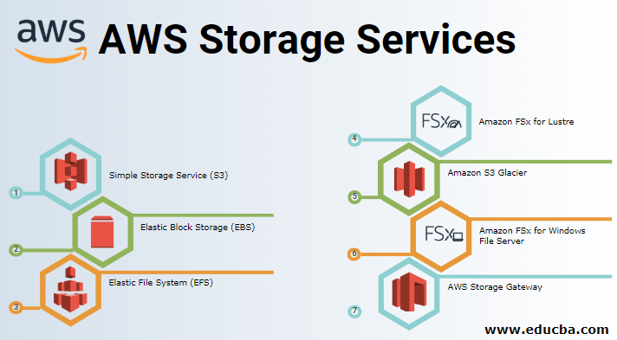

Slide 4
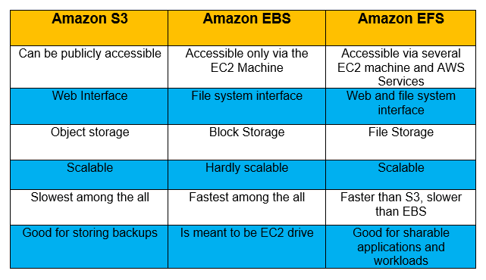

Slide 5
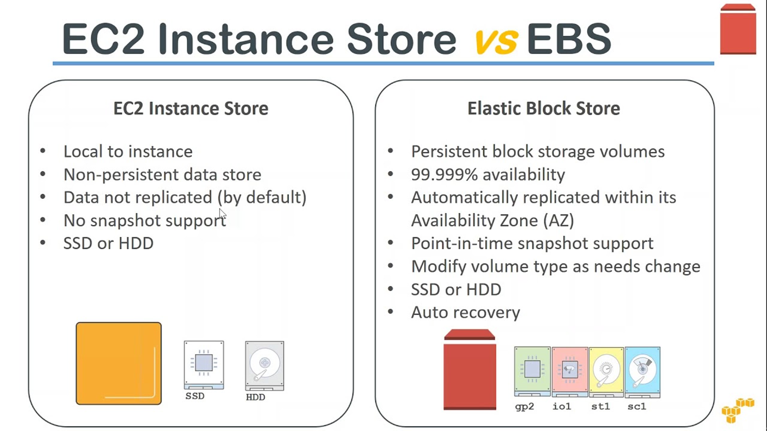

Slide 6
Snapshots / volume
EBS Snapshots
This are a point-in-time copy of your data, and can be used to enable disaster recovery, migrate data across regions and accounts, and improve backup compliance. You can create and manage your EBS Snapshots through the AWS Management Console, AWS Command Line Interface (CLI), or the AWS SDKs.
EBS volume
It’s a durable, block-level storage device that you can attach to your instances. After you attach a volume to an instance, you can use it as you would use a physical hard drive.
Provisioned IOPS SSD (io2 Block Express, io2, and io1).
General Purpose SSD (gp3 and gp2).
Throughput Optimized HDD (st1).
Cold HDD (sc1).

Slide 7
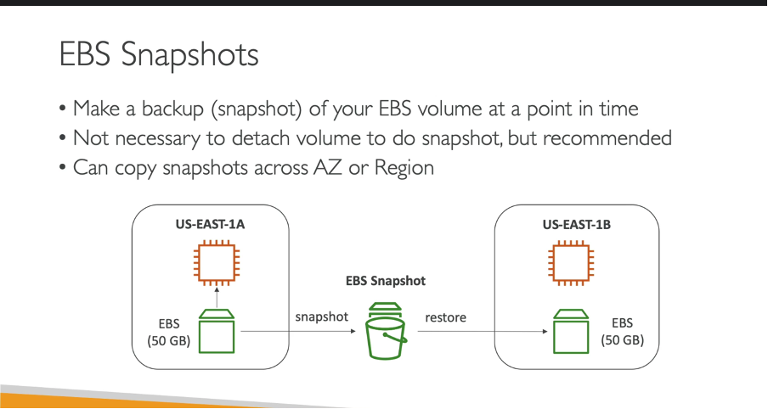

Slide 8
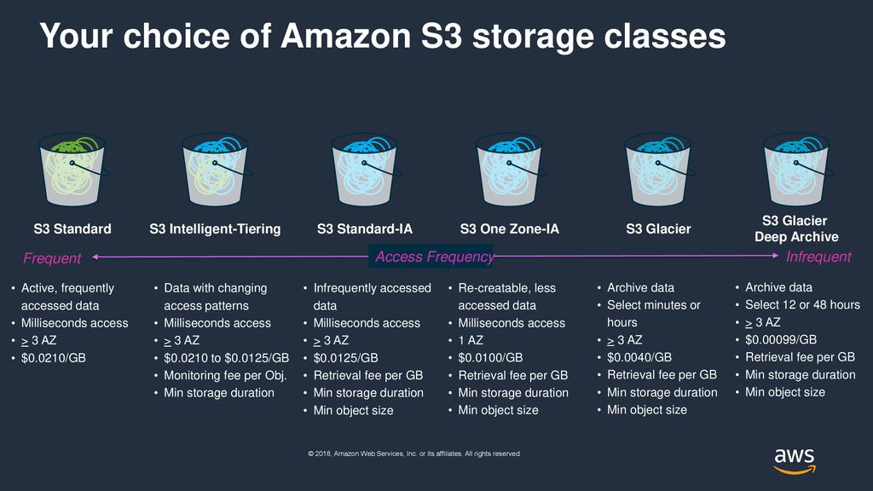

Slide 9
SRR / CRR
SRR – Same Region Replication
It’s an S3 feature that automatically replicates data between buckets within the same AWS Region.
With SRR, you can set up replication at a bucket level, a shared prefix level, or an object level using S3 object tags. You can use SRR to make one or more copies of your data in the same AWS Region.
CRR - Cross Region Replication
It’s an Amazon S3 feature that automatically replicates every object uploaded to an S3 bucket to a destination bucket in a different AWS Region that you choose.
S3 object tags are key-value pairs applied to S3 objects that allow you to better organize, secure, and manage your data stored in S3

Slide 10
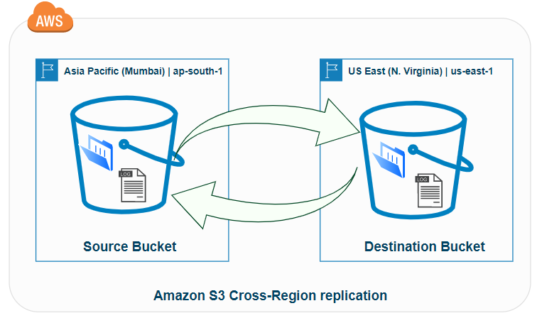
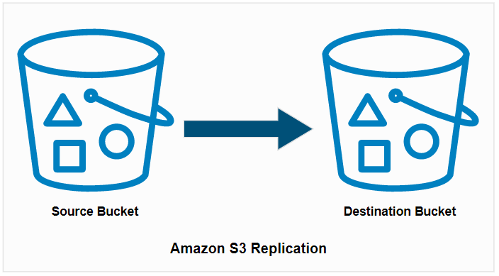
Same-Region replication (SRR)
&
Cross-Region replication (CRR)

Slide 11
Glacier (WORM) Lock / S3 Object Lock
S3 Glacier Vault Lock
It allows you to easily deploy and enforce compliance controls for individual S3 Glacier vaults with a vault lock policy. You can specify controls such as “write once read many” (WORM) in a vault lock policy and lock the policy from future edits. Once locked, the policy can no longer be changed.
Amazon S3 Object Lock
It’s an Amazon S3 feature that allows you to store objects using a write once, read many (WORM) model. You can use WORM protection for scenarios where it is imperative that data is not changed or deleted after it has been written

Slide 12
Amazon (S3) - Versioning /Amazon (S3) - Replication
Amazon (S3) - Versioning
It’s a means of keeping multiple variants of an object in the same bucket. You can use the S3 Versioning feature to preserve, retrieve, and restore every version of every object stored in your buckets.
Amazon (S3) – Replication
It’s an elastic, fully managed, low cost feature that replicates objects between buckets. S3 Replication offers the most flexibility and functionality in cloud storage, giving you the controls you need to meet your data sovereignty and other business needs.

Slide 13
Why DNS is Called as Route53 in AWS
DNS (or) Domain Name System
translates human readable domain names (for example, www.amazon.com) to machine readable IP addresses (for example, 192.0. 2.44).
Ex:- A DNS service such as Amazon Route 53 is a globally distributed service that translates human readable names like www.example.com into the numeric IP addresses.
AWS Route 53
takes its name with reference to Port 53, which handles DNS for both the TCP and UDP traffic requests
Amazon Route 53 effectively connects user requests to infrastructure running in AWS – such as Amazon EC2 instances, Elastic Load Balancing load balancers, or Amazon S3 buckets – and can also be used to route users to infrastructure outside of AWS.

Slide 14
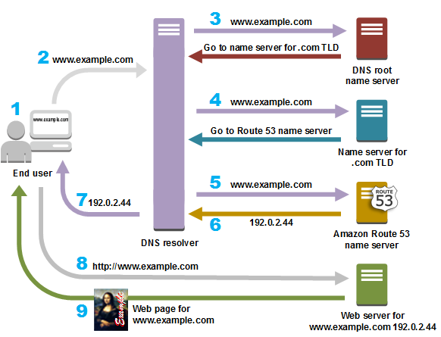

Slide 15
Sub-domain
A sub-domain name is a piece of additional information added to the beginning of a website's domain name.
It allows websites to separate and organize content for a specific function
— such as a blog or an online store — from the rest of your website.
A sub-domain is the portion of a URL that comes before the “main” domain name and the domain extension.
For example :- docs.themeisle.com .
Subdomains can help you divide your website into logical parts or create separate sites, for example a separate blog for each sports team.

Slide 16
Feature Of Route 53
  Domain registration.
  DNS hosting.
  DNS routing Policy
  Health checking.
  Traffic management.

Slide 17
Auto Scaling / Auto Scaling Group
Auto Scaling
It monitors your applications and automatically adjusts capacity to maintain steady
It's easy to setup application scaling for multiple resources across multiple services in minutes.
It helps you maintain application availability and allows you to automatically add or remove EC2 instances according to conditions you define.
Auto Scaling group
contains a collection of Amazon EC2 instances that are treated as a logical grouping for the purposes of automatic scaling and management.
An Auto Scaling group also enables you to use Amazon EC2 Auto Scaling features such as health check replacements and scaling policies.

Slide 18
Single Point Of Failure / Elastic Load Balancing
single point of failure
Single points of failure occur when a single Cloud HSM device fails in a non-HA configuration, which can result in the permanent loss of keys and data.
The HA partition group, however, allows for one or more Cloud HSM devices to fail, while still keeping your environment operational.
Elastic Load Balancing
Elastic Load Balancing automatically distributes your incoming traffic across multiple targets, such as EC2 instances, containers, and IP addresses, in one or more Availability Zones.
It monitors the health of its registered targets, and routes traffic only to the healthy targets.

Slide 19
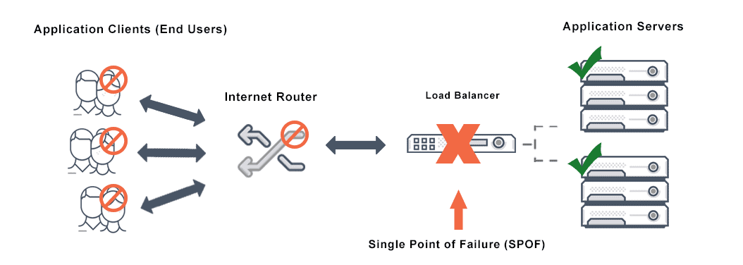
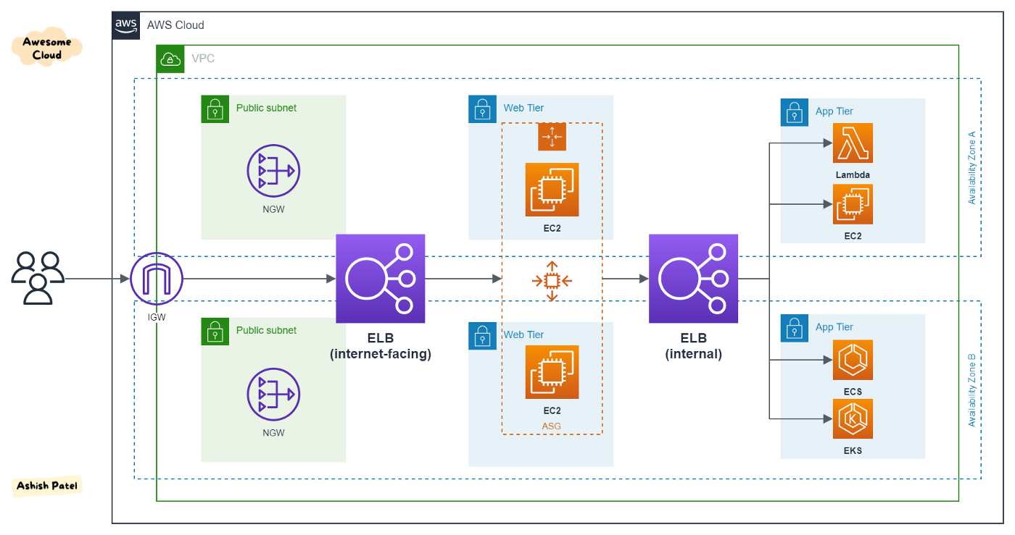

Slide 20
High Availability / Fault Tolerance
High availability
It’s a software solutions offer data protection for all the legacy file data that businesses want to move to Amazon Web Services (AWS), as well as reliable performance with minimal downtime and costs.
Fault tolerance
It’s the ability of a workload to remain operational with zero downtime or data loss in the event of a disruption. In a fault-tolerant environment, instances of the same workload are typically hosted on two or more independent sets of servers

Slide 21
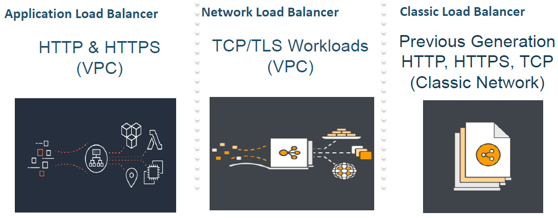
Types Of Load Balancers In AWS
Elastic Load Balancing supports the following types of load balancers:
Application Load Balancers.
Network Load Balancers.
Classic Load Balancers.

Slide 22
A Launch Template
A launch template provides full functionality for Amazon EC2 Auto Scaling
It reduces the number of steps that are required to create an AWS instance by capturing all launch parameters within one resource.
Also, newer features of Amazon EC2 such as the current generation of Amazon EBS
(a) Provisioned IOPS volumes (io2)
(b) EBS volume tagging
(c) T2 Unlimited instances
(d) Elastic Inference
(e) Dedicated Hosts.

Slide 23
VPC
virtual private cloud (VPC)
is a virtual network dedicated to your AWS account. It is logically isolated from other virtual networks in the AWS Cloud.
You can launch your AWS resources, such as Amazon EC2 instances, into your VPC
You can specify an IP address range for the VPC, add subnets, associate security groups, and configure route tables.
USE:
Amazon VPC enables you to build a virtual network in the AWS cloud
You can define your own network space, and control how your network and the Amazon EC2 resources inside your network are exposed to the Internet.

Slide 24
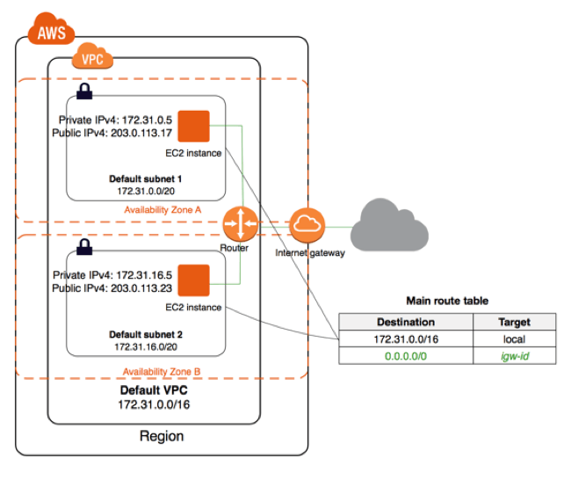

Slide 25
Thank you

